Slide 2
Hallmoor school provides the competence and confidence to maximise the living of independent lives.

Slide 3
Curriculum Aims:
Intent
promote curiosity of learning
develop a love of reading
develop communication
develop aspirational career prospects
develop independence
build resilience
promote active community inclusion
promote physically and mentally healthy lifestyles
Implementation
Impact

Slide 4
Intent
Curriculum Aims:
We intend to provide our pupils with a curriculum that is structured and well sequenced, catering for pupils aged 4-19 years old. Our pupils at Hallmoor School have a diagnosis of various learning needs ranging from moderate to complex and face many challenges.
We use communication and teaching strategies designed to helping pupils overcome any potential barriers to learning. Our staff show high levels of emotional competence. We deliver high quality teaching that is based on accurate assessment and focuses on the basic knowledge and skills that each pupil will need in their lives. Our curriculum provides opportunities for pupils to rehearse and revisit learning within and across lessons and subject curricula. Pupils will be given opportunities to apply their learning with increasing independence in the wider community. We teach pupils to keep themselves and others safe and healthy and work closely with parents to promote this at home and in the community. We set pupils off on a journey of personal discovery to develop interests and curiosity about the world around them which is used to inform pupils choices through a well-planned careers programme.
Intent
Implementation
Impact

Slide 5
Implementation
Curriculum Aims:
Hallmoor School is arranged into four curriculum Phases:
Primary (EYFS, Key Stage 1 and 2)
Middle (Key Stage 3)
Upper (Key Stage 4)
Sixth Form (Key stage 5).
The curriculum is broad and balanced and is based on the National Curriculum. Pupils at Hallmoor are working below national age-related expectations and appropriate adaptations are made for pupils to be able to access the suggested themes and content.
Intent
Implementation
Impact

Slide 6
Impact
Curriculum Aims:
Intent
Develop Independence into adulthood.
Communicate their own needs.
Live a fulfilled happy life.
Achieve their aspirational goals.
Implementation
Impact

Slide 7
Primary
Key Stage 3
Key Stage 4
Sixth Form
4 Phases of learning
Adulthood

Slide 8
3 Pathways in each Phase
Formal Pathway
Bridge Pathway
Semi-Formal Pathway

Slide 9
3 Pathways in each Phase
The Pathways represent levels of learning, a set curriculum of appropriate subjects. For example, The semi-formal Pathway includes the “World About Me” rather than History, Geography and RE which are included on the Formal curriculum.
When putting class lists together there are two main factors that determine groupings, the most suitable Pathway and chronological age. Where possible we only have two year groups represented in one class. For example, year 1 and 2 pupils.
Pathways are determined by initial assessment and are reviewed annually (pupils can change pathway depending on progress).

Slide 10
Primary
KS3
KS4
Sixth Form
Formal
English, Maths, Science, PSHE/RE, PE, Computing, RE, DT, Music, Humanities (History, Geography), Art and Design, Enrichment, Phonics/Reading
English, Maths, Science, PSHE/RE, PE, Computing, RE, DT, Music, Humanities (History, Geography), Art and Design, Enrichment, Phonics/Reading
English, Maths, Science, PSHE/RSE, PE, ICT, Options, Enrichment, Phonics/Reading
English, Maths, ICT, Citizenship, PSHE/RSE, Careers and Employability, PE, Enrichment, Vocational Options, Reading
Bridge
English, Maths, Scientific Technologies, PSHE/RE, PE, Creative Arts, Music and Movement, Understanding the World, Enrichment, Phonics/Reading
English, Maths, Independence/Life Skills, Science, PSHE/RSE, PE, Computing, RE, DT, Music, Humanities (History, Geography), Art and Design, Enrichment, Phonics/Reading
English, Maths, Science, PSHE/RSE, PE, ICT, Options, Enrichment, Phonics/Reading
English, Maths, ICT, PSHE/RSE, Careers and Employability, PE, Enrichment, Vocational Options, Phonics/Reading
Semi-Formal
Communication, Literacy, Maths, Understanding the World, Physical Wellbeing, Music and Movement, Creative Arts, Outdoor-School/ Enrichment, PSED, Phonics/Reading
Communication, Literacy, Maths, Understanding the World, Physical Wellbeing, Music and Movement, Creative Arts, Outdoor-School/ Enrichment, PSED, Phonics/Reading
English, Maths, Science, PSHE/RSE, PE, Independence/Life Skills, ICT, Options, Phonics/Reading, Enrichment
Life Skills: English, Maths, Life Skills.
PSHE/RSE, PE. Enrichment, Vocational Options, Phonics/Reading

Slide 11
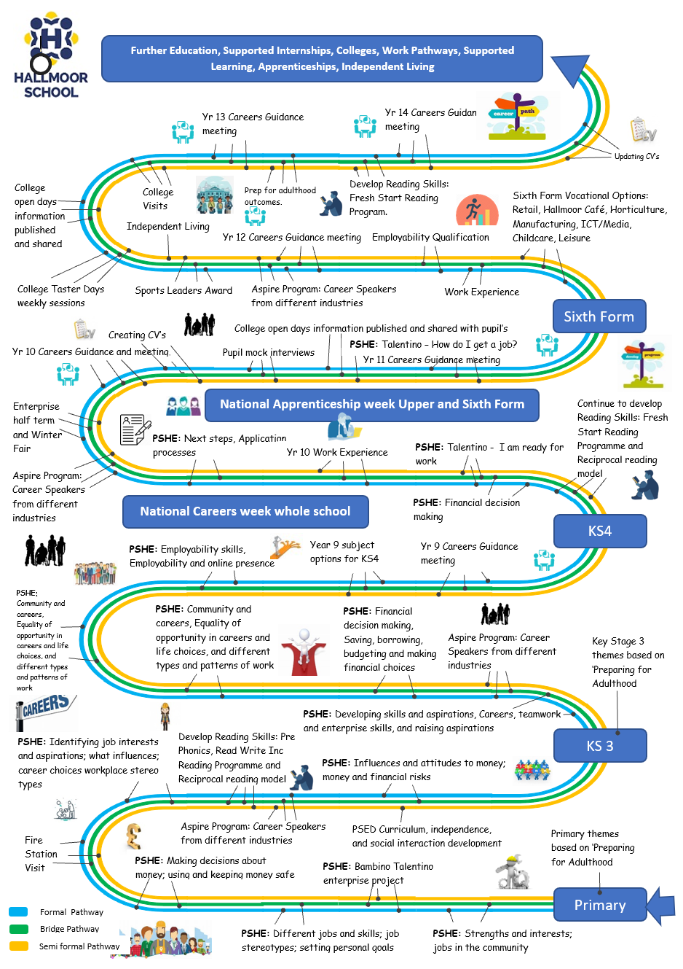
Pathways relate to destinations of our pupils. These are highlighted on Hallmoor’s career Education Programme. https://hallmoor.fet.ac/our-curriculum/careers-education/

Slide 12
Destination Assessment Outcomes that inform Selection of National Curriculum Content and Accreditation Suitability
Phase | Primary | Key Stage 3 | Key Stage 4 | 6th Form | Adulthood
Curriculum Pathways | End of Key Stage 2 | End of Key Stage 3 | End of Key stage 4 | End of Sixth Form | Destinations beyond 19
Formal | Pupils work on average between A2E Band 5-9. A minority may achieve A2E Band 10 or above. | Pupils work on average between A2E Band 7- Band 12. A minority may achieve A2E Band 13 or above. | Pupils work on average between Entry 2-3. A minority may achieve Level 1. | Pupils work on average between Entry 3 and Level 1. A minority may achieve a Level 2. | Independent Travel/ Vocational College courses/Independent placements Access to further education leading to Employability / Apprenticeships Vocational Education Level 1+
Bridge | Pupils work between A2E Band 4/SF10 - Band 6/SF11. | Pupils work between A2E Band 5/SF11 - Band10/SF14. | Pupils work on average between Entry 1-2. | Pupils work on average between Entry 2-3. | Independent-Supported Travel/ Access to college courses to further develop individual skills towards supported or independent employment.
Semi-Formal | Pupils work between PF4 – A2E Band 3/SF9. | Pupils work between A2E Band 1/SF5 -Band 4/SF11 | Pupils work on average between Pre-Entry - Entry 1. | Pupils work on average between Pre-Entry - Entry 1. | Supported travel/ continue to use strategies or tools to further develop communication and sensory integration/ independent living college placement.

Slide 13
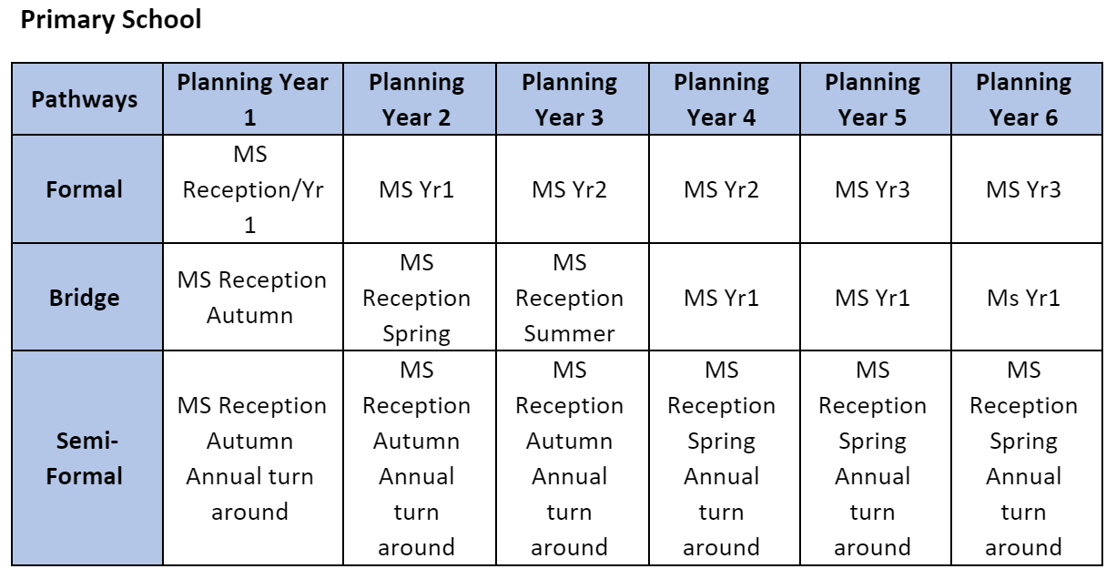
Curriculum Content Selection Overview For English and Mathematics
This is the converted equivalent from Banding to Mainstream National Curriculum content.
Primary School

Slide 14
Curriculum Content Selection Overview For English and Mathematics
This is the converted equivalent from Banding to Mainstream National Curriculum content.

Slide 15
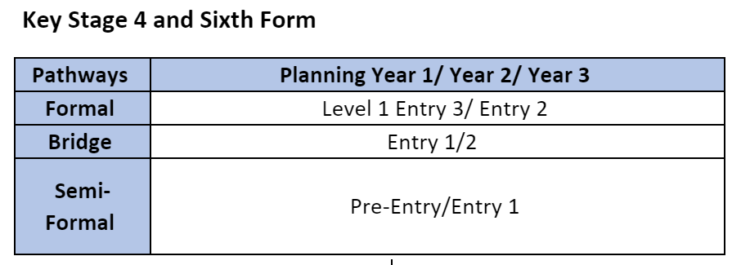
Curriculum Content Selection Overview For English and Mathematics
This is the converted equivalent from Banding to Mainstream National Curriculum content.

Slide 16
Our Curriculum is sequenced
Through the use of the National Curriculum content across Phases and Pathways.
Through the broad and balanced subjects studied that lead into the range of Core accreditations and options in Key Stage 4 and Sixth form.

Slide 17
Curriculum Subject Mapping
Sequencing of Subjects
Subject Type | Primary | Key Stage 3 | Key Stage 4 | Sixth Form
Core | English/Phonics/ Reading/ My Communication/ Early Sounds | English/Phonics/ Reading/ My Communication/ Early Sounds | English/ Phonics/ Reading/ Comprehension | English/ Phonics/ Reading/ Comprehension
 | Mathematics/ My Thinking and Problem Solving | Mathematics / My Thinking and Problem Solving | Mathematics | Mathematics
 | Science/ The World About Me | Science/ The World About Me | Science/ Health and Social Care/ Animal Care | Health and Social Care/ Animal Care/ Horticulture
Foundation | Computing | Computing, Learning Ladders | Computing/Media | Computing and Software/ Media
 | PSHE RE/ The World About Me/ Enrichment | PSHE RSE/ The World About Me/ Enrichment | PSHE RSE/ Enrichment | Life Skills Financial/ Enrichment
 | Physical Education/ My Physical Well-being | Physical Education/ My Physical Well-being | Physical Education Core/ Outdoor Learning/Horticulture/Sport Studies | Outdoor Learning/Horticulture/Sport Studies/ Sport and Leisure
 | Religious Education/ The World About Me | Religious Education/ The World About Me | Humanities | Humanities
Compulsory/ Entitlement | Art and Design/ My Art | Art and Design/ My Art | Art and Design/ Textiles | Art and Design/ Textiles/ Hair and Beauty
 | Design Technology and Food Technology/ My Art | Design Technology and Food Technology/ My Art | Food Tech/ Enterprise/ Retail | Food Tech/ Hospitality and Catering/ Enterprise/ Retail/ Building and Construction
 | Humanities Geography and History | Humanities Geography and History | Humanities | Humanities
 | Outdoor Learning/ Forest School | Outdoor Learning Forest School | Outdoor Learning | Outdoor Learning
 | Music/ My Music/ The World About Me | Music/ Drama/ The World About Me | Music/ Performing Arts | Performing Arts

Slide 18
Pupil Progress
We measure pupil progress in Primary and Key Stage 3 through the use A2E (Access to Education) statements, developed by Birmingham Council.
We also use Pre-Formal (Engagement Model for a select few pupils) and the Semi-Formal Ladders .
These assessment systems will be combined for September 2023. Therefore, banding equivalents will be slightly changing. The reason for the combination is to incorporate the updates from birth to 5 assessments in the EYFS framework.
The combination will provide smaller steps of progression up to the equivalent of Mainstream Year 2 expectations. As well as be easier to calculate pupil progress on one system.

Slide 19
Hallmoor Assessment Model
Our Data Model shows comparative levels.
Some changes will be made to this document for September 2023.
The Engagement Model
Standard 1
Standard 2
Standard 3
Standard 4
Standard 5
Standard 6
GCSE
0
0
0/1
0/1
1
1
2
2
3
3
4
4/5
5
5/6
Pre and Early Entry Level 1
Entry Level 1
Entry Level 2
Entry Level 3
Level 1
Level 2
A 3
A 4
A 5
A 6
A 7
A 8
A 9
A 10
A 11
A 12
A13
A 14
A 15
A 16
A 17
A 18
A 19
A 20
A 21
A 22
A 23
A 24
A 25
A 26
A 27
A 28
A 29
A 30
A31
A 32
A33
A 34
B1
B2
B3
B4
B5
B6
B7
B8
B9
B10
B11
B12
B13
B14
B15
B16
A2E and Progression Ladders
PF 4 Pre-Formal SF 5-14 Semi-Formal Pathway
Formal Pathways
Mainstream
End of Nursery
End of Reception
End of Yr 2
End of Yr 4
End of Yr 6
End of Yr 9
End of Yr 11
Reviewed May 2023

Slide 20
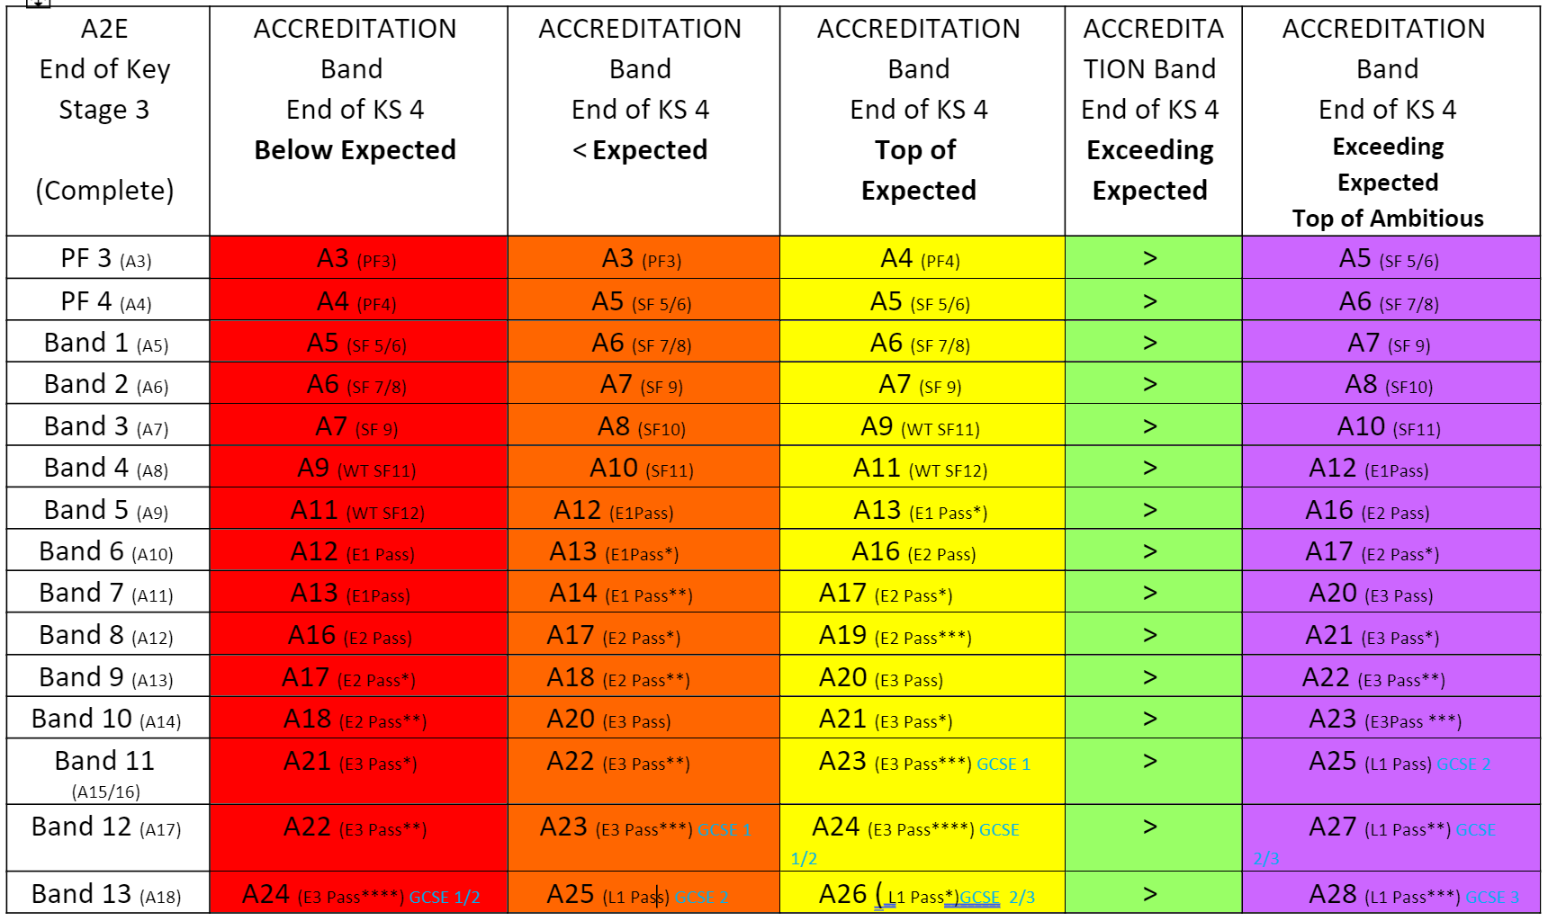
Progress expectations are calculated through the use of Flight paths for example below is the flight path from end of Key Stage 3 to 4.

Slide 21
Long-Term and Medium-Term planning
All Long-Term plans include the break down of development for the pupils in the phase to work towards preparing for adulthood.
In Primary pupils prepare for the next stage in Key Stage 3. 3-4, and 4 to sixth form.

Slide 22
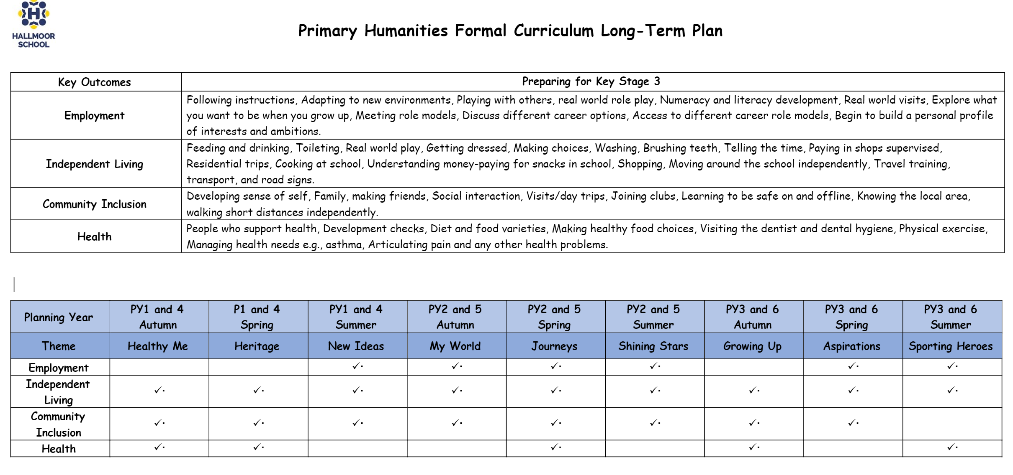
This also shows how the themes relate to the preparing for adulthood outcomes.

Slide 23
Primary and Key Stage 3 use a theme-based learning focus for each term.
The themes relate to the preparing for adulthood outcomes.

Slide 24
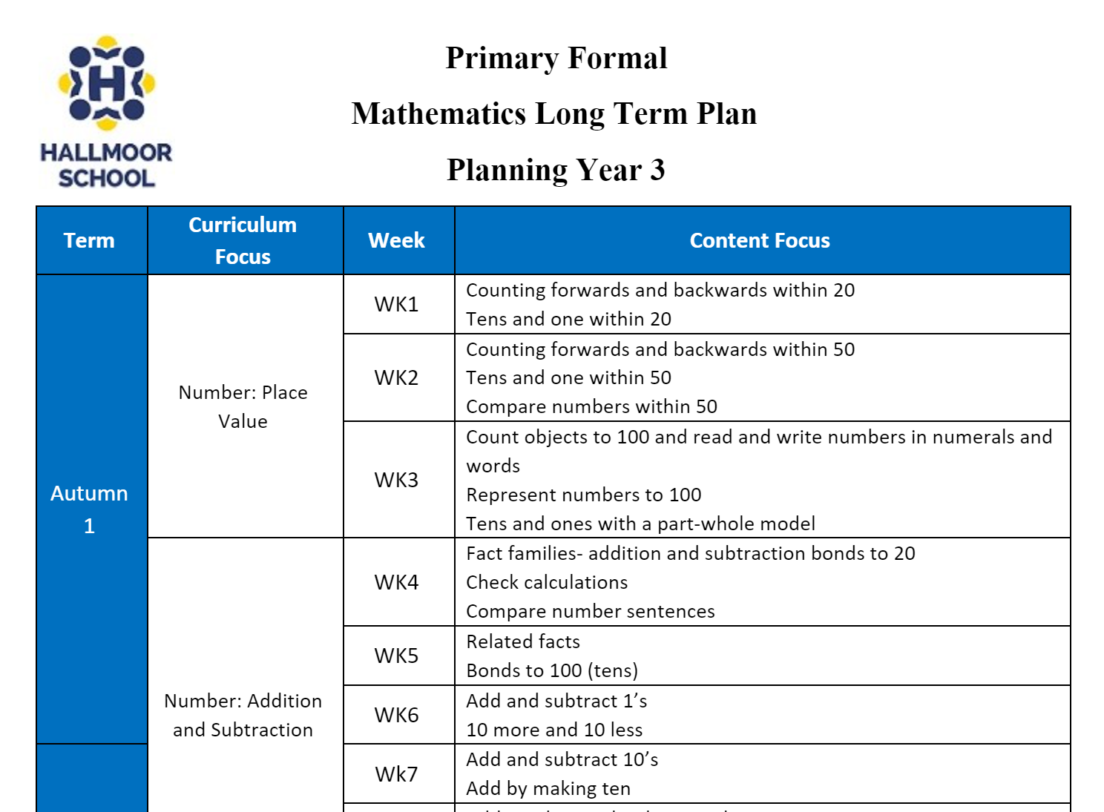
Long term Plans in Primary and Key Stage three.
Provide an overview of the content to be taught.
Maths and English LTP’s also contain a progression of skills to be covered for that Phase and Pathway.

Slide 25
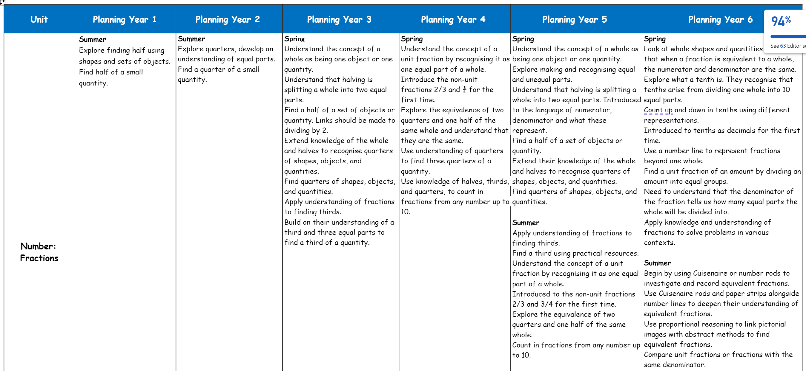
Primary Formal Maths Skill Progression

Slide 26
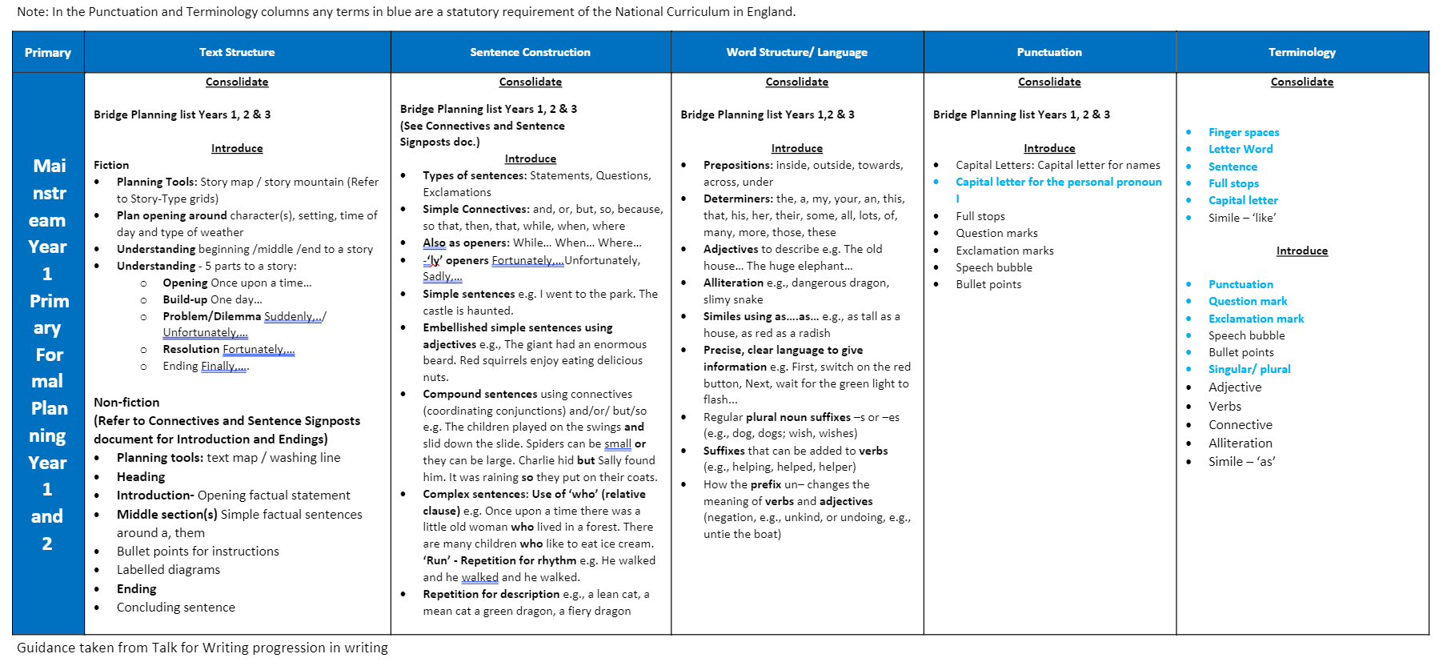
Primary Formal English Skill Progression (Talk For Writing)

Slide 27
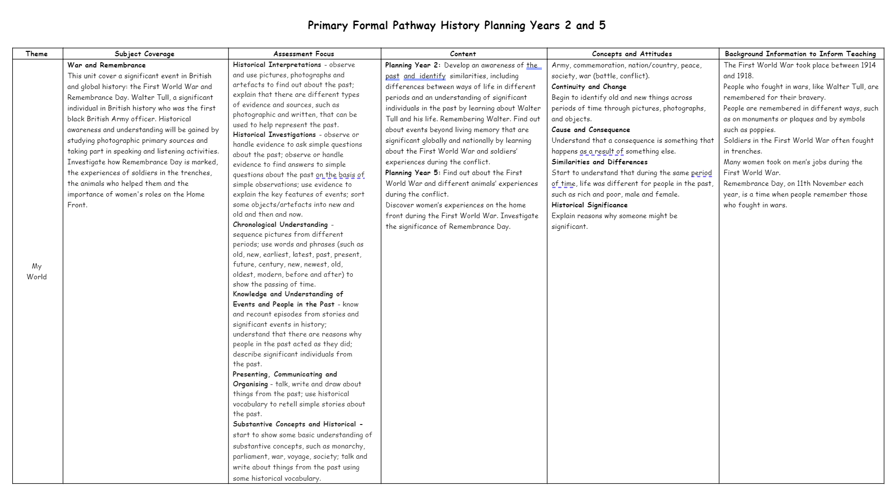
Other Subjects are under development

Slide 28
Curriculum Statement

